Slide 1
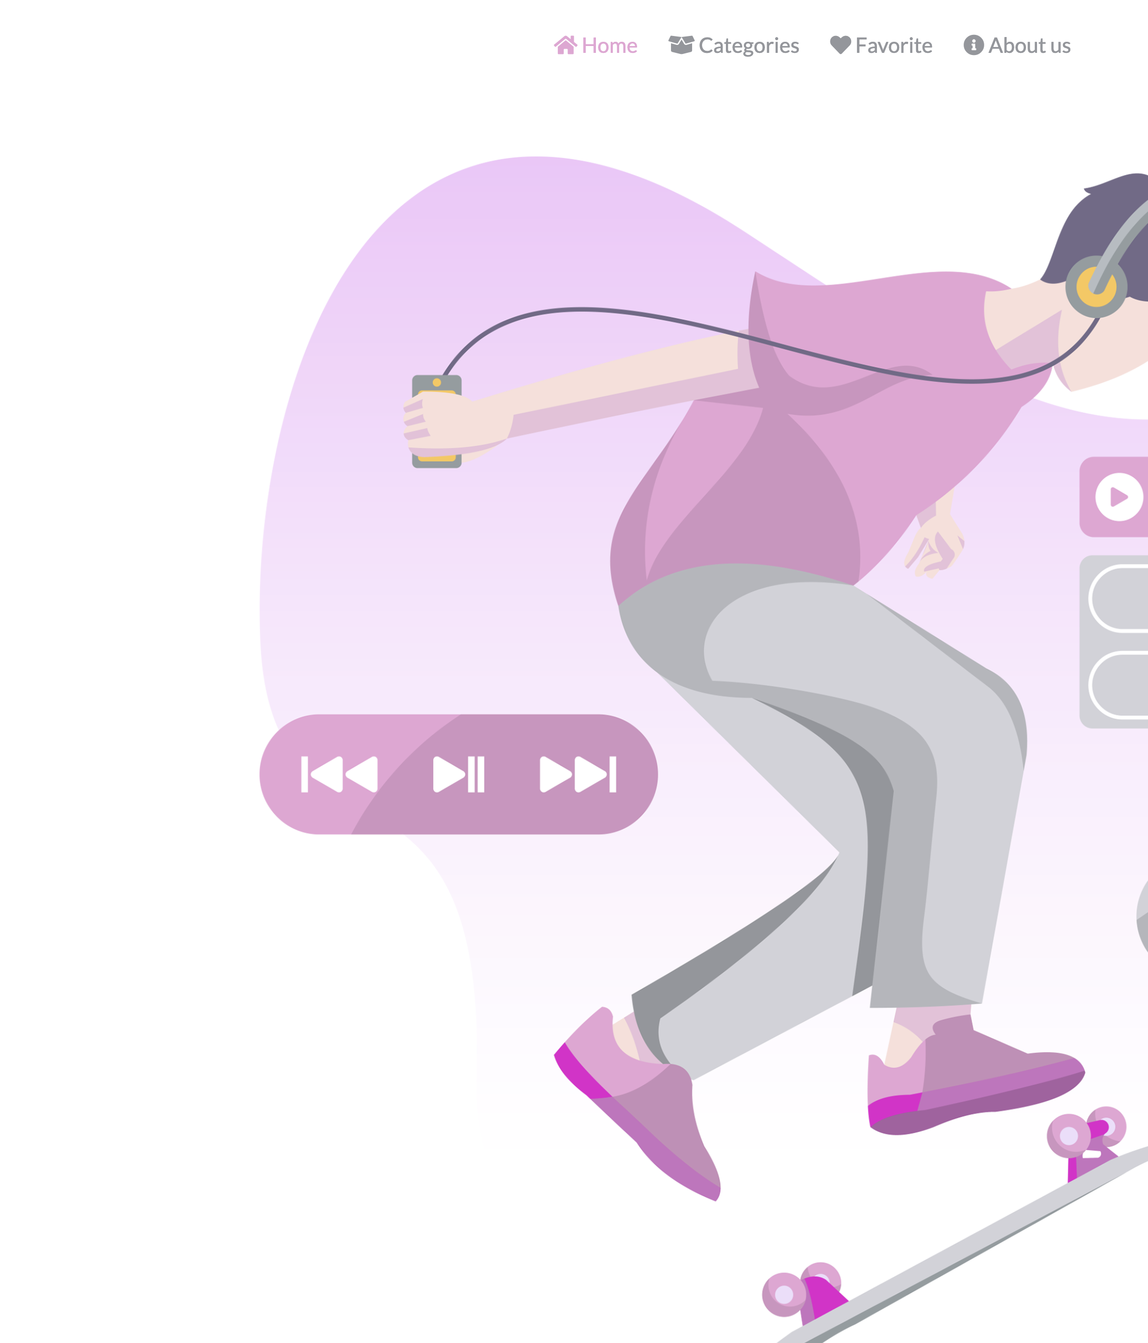
Welcome t myMusic Web app
A website to fetch playlists from spotify API and save favorite playlists in local storage
Content:
- HTML pages structure
- Grid system
-javascript :
- Fetch playlists
- localStorage (favorite playlists)

Slide 2
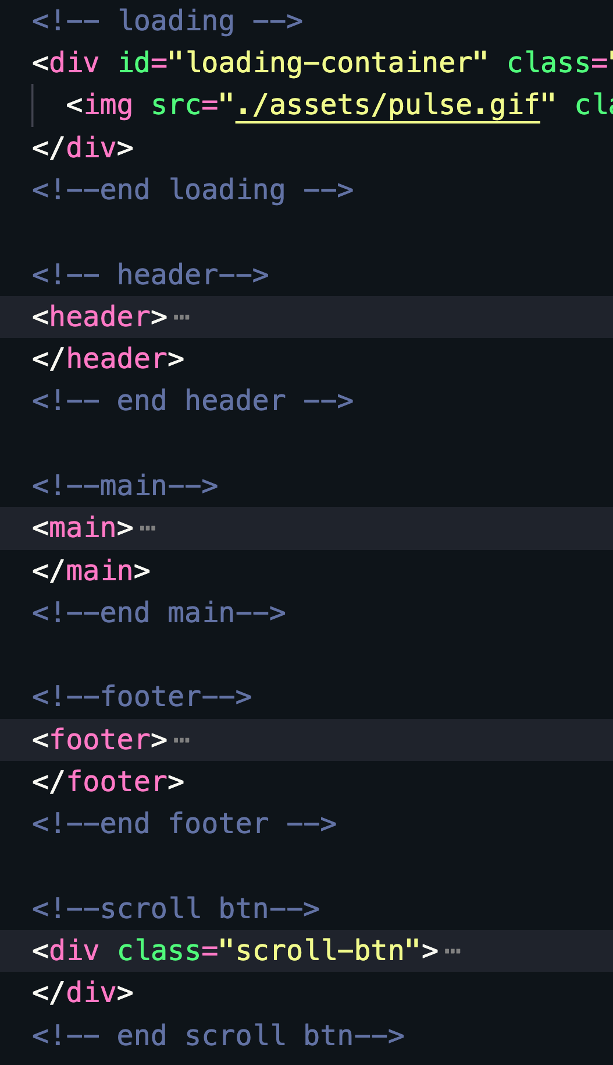
Page HTML structure
Loading –container: display spinner until page loads
Header contains : logo nav
Main : page content
Footer : logo – links – social media buttons
Scroll-btn: displays scroll button to scroll to top of the page

Slide 3
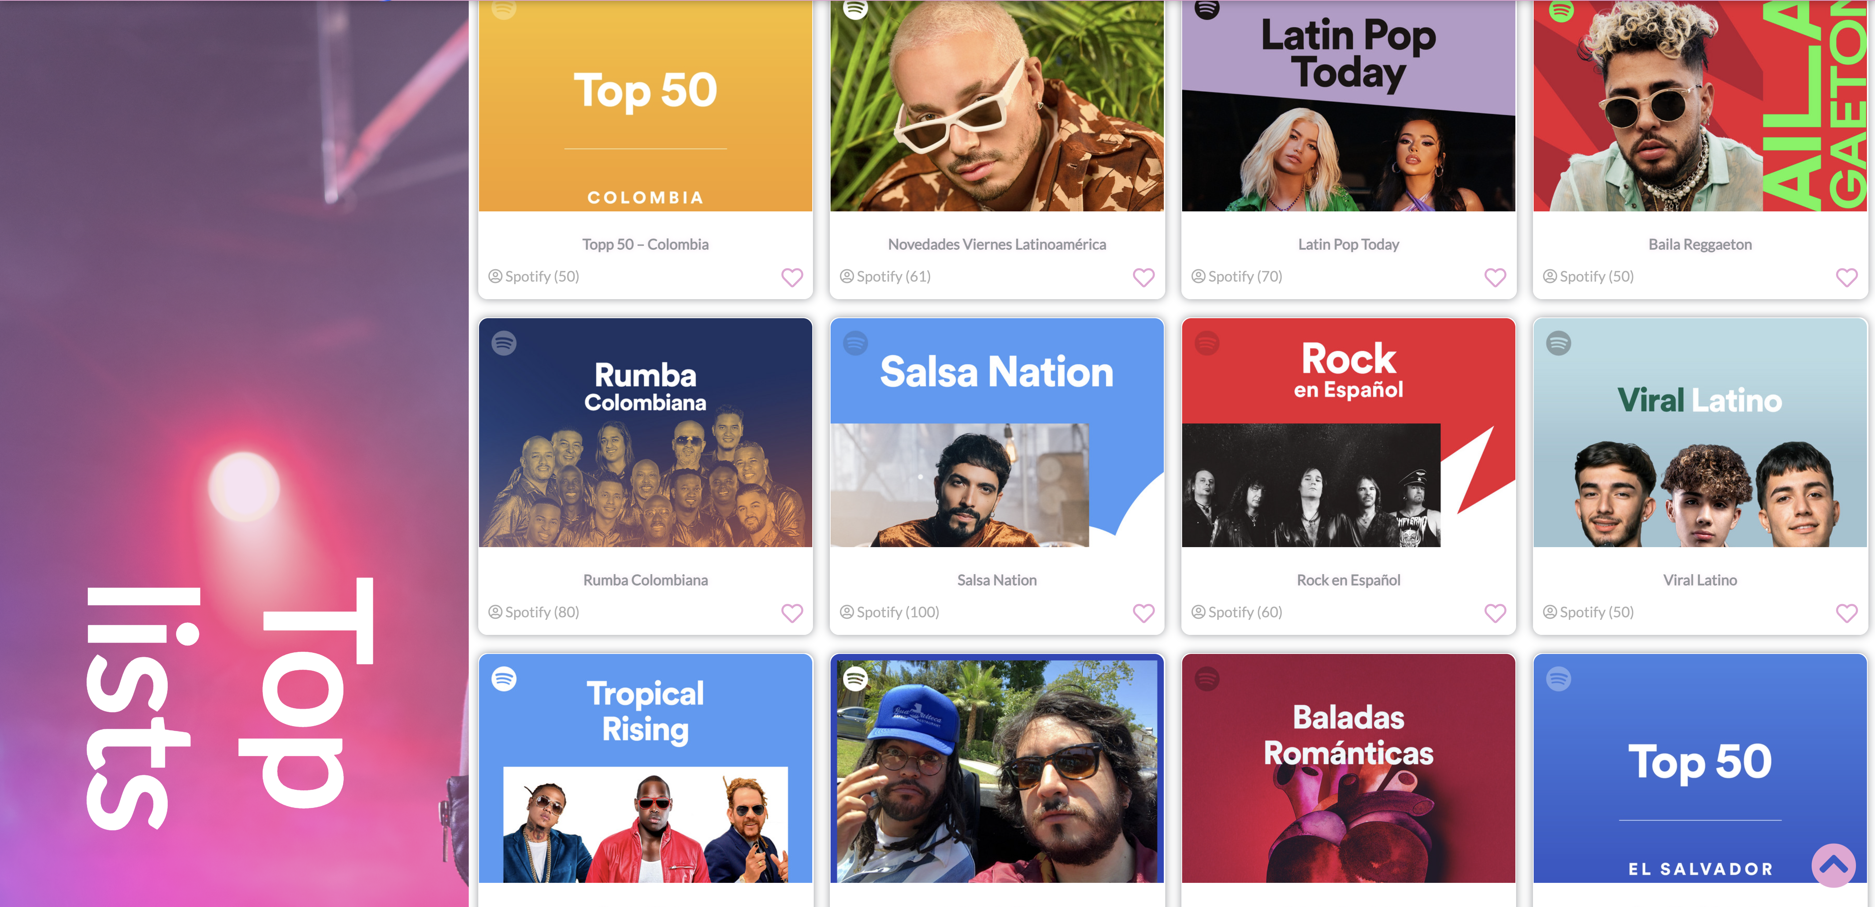
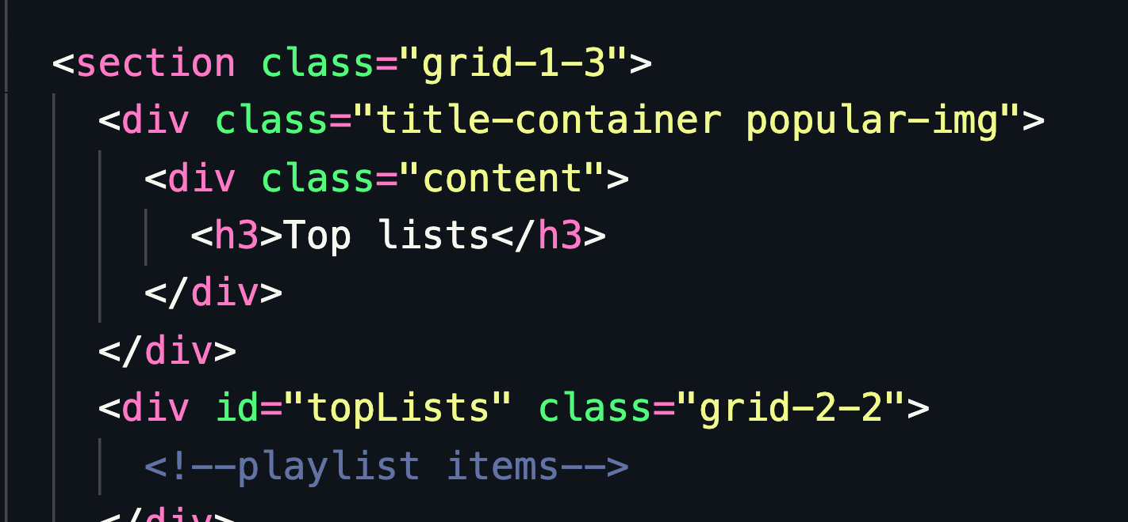
Grid System
We have here main Grid
1fr – 3fr
3fr : contains a child grid
Which has 4fr in large pages

Slide 4
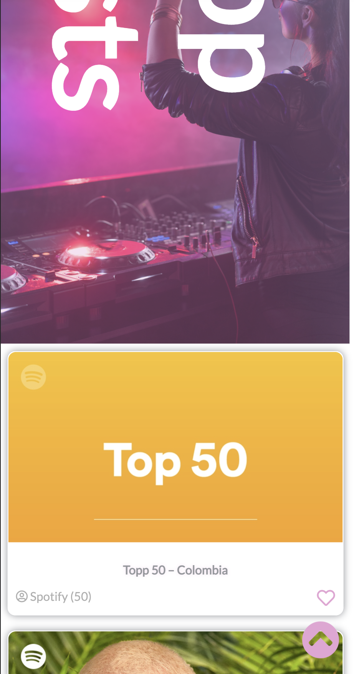
In x-small Screens
@media only screen and (max-width: 600px) {
grid-template-columns: 1fr;
}

Slide 5
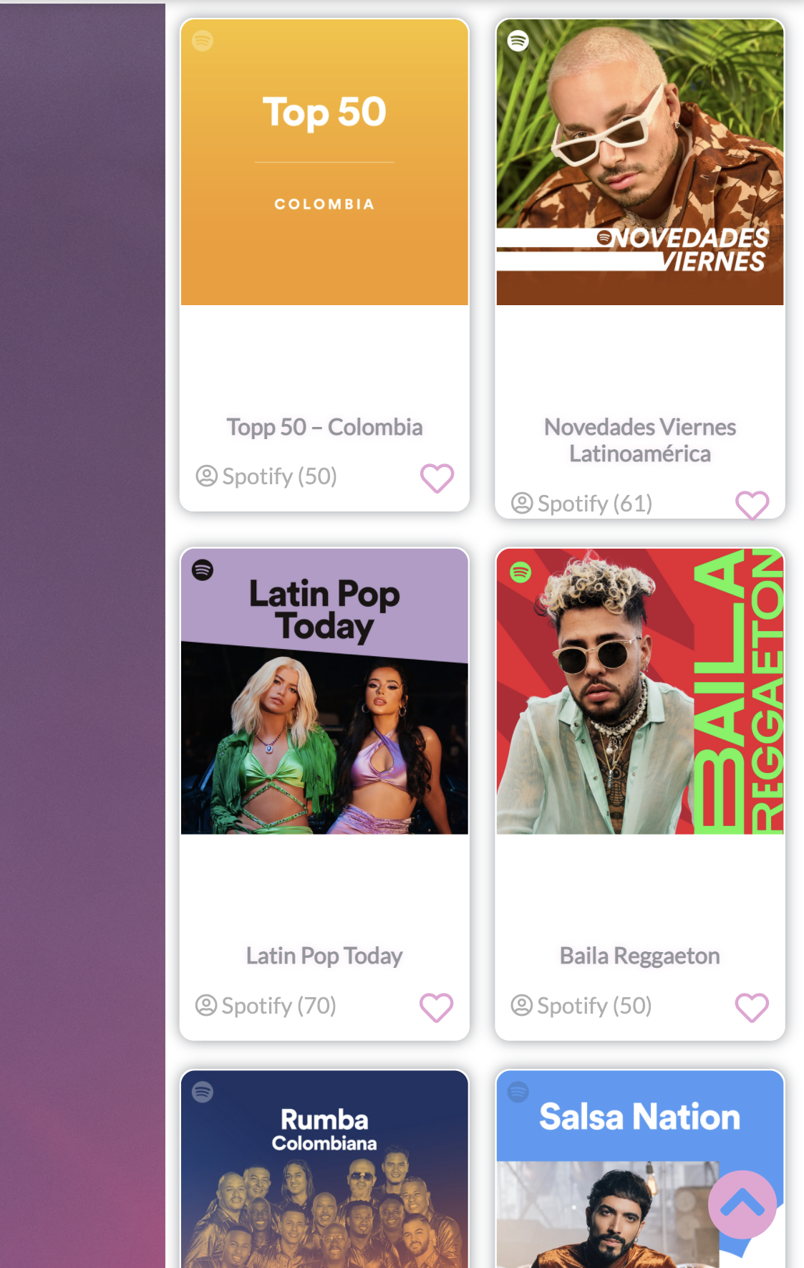
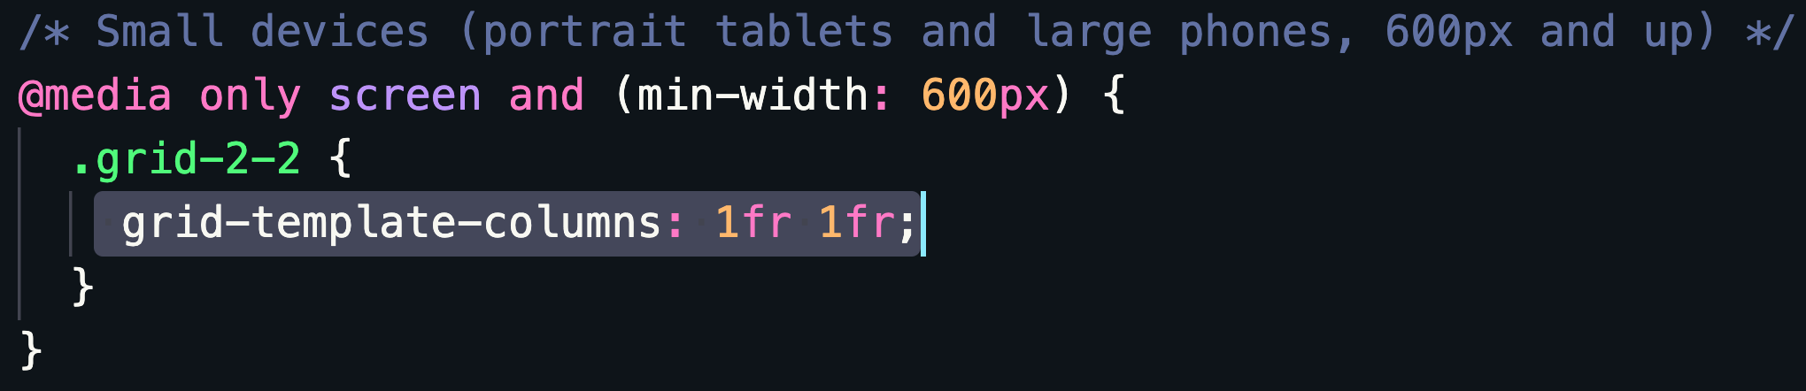

Slide 6
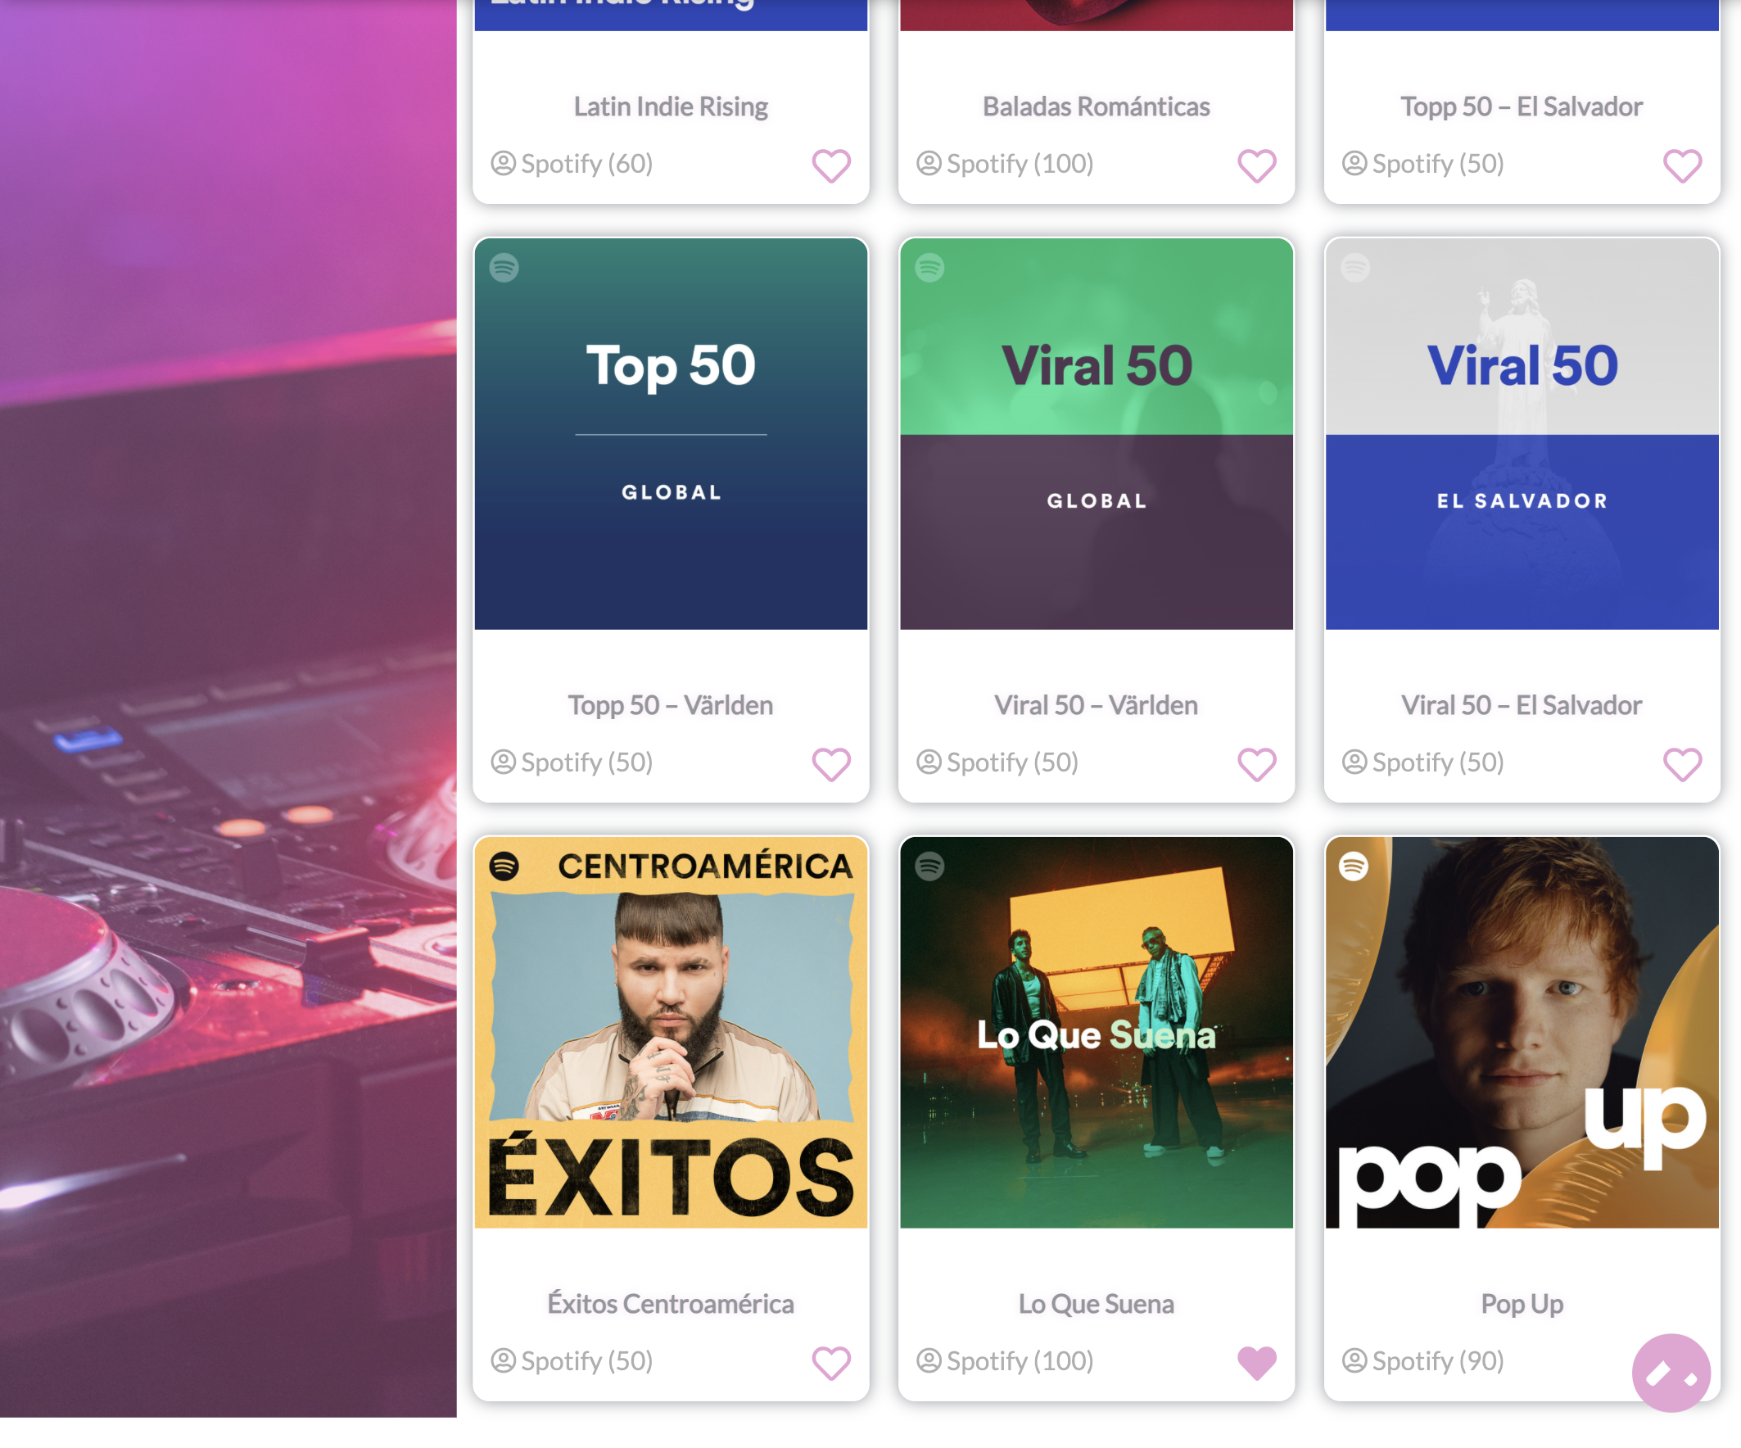
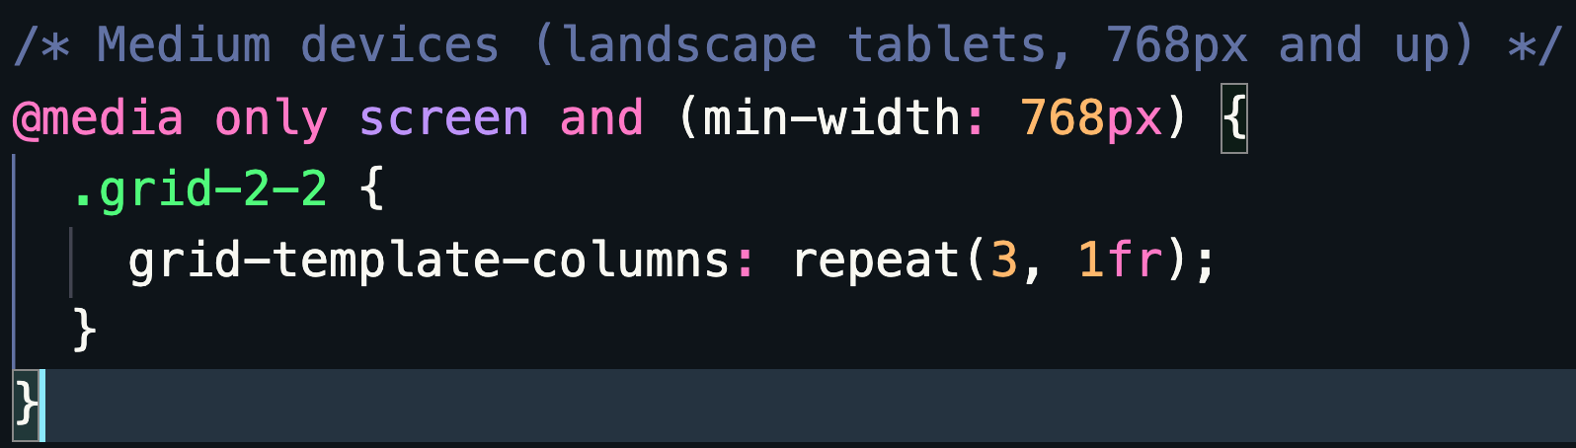
Medium screens

Slide 7
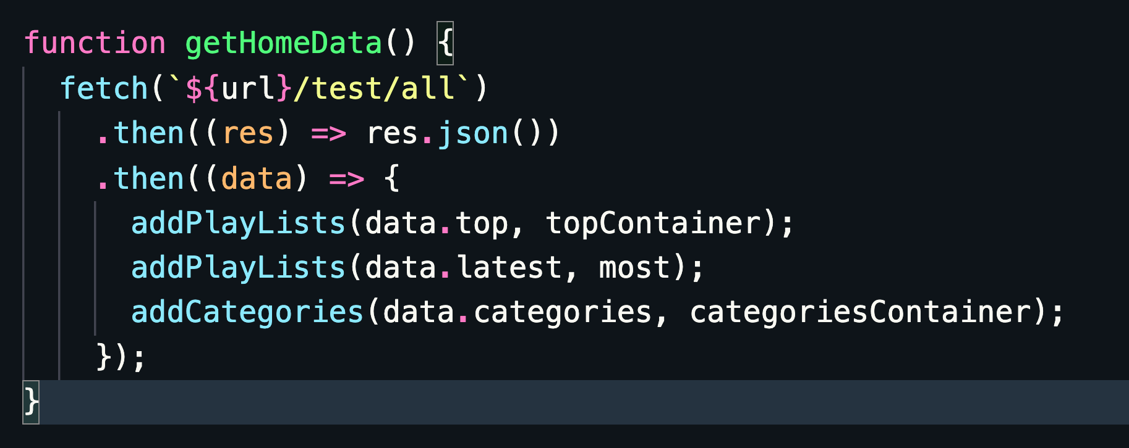
Fetch Home data

Slide 8
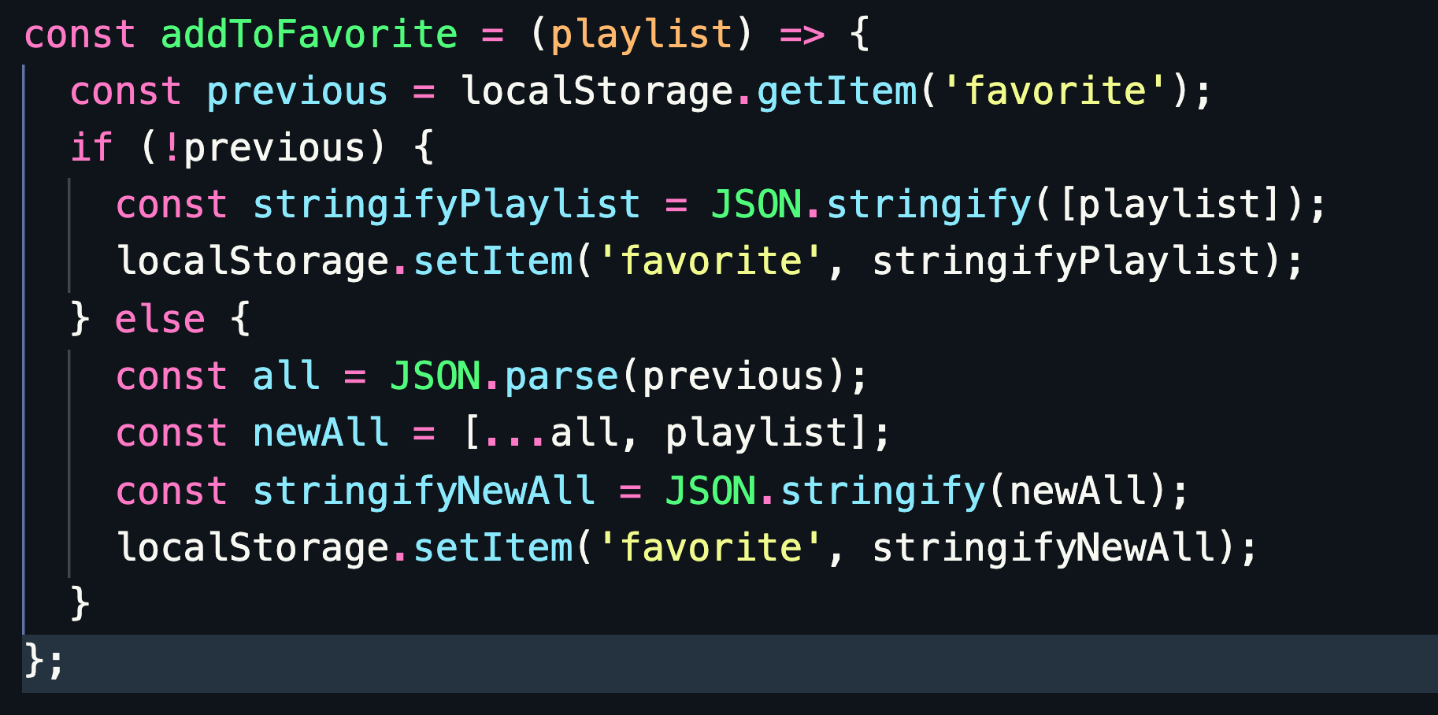
Add to favorite list

Slide 9
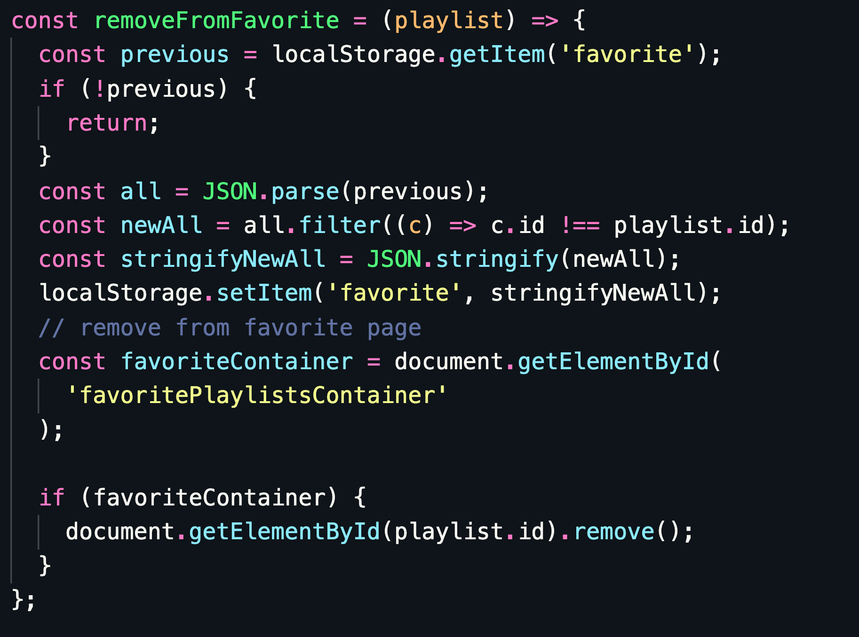
Remove from favorite list

Slide 10

Thanks

